Slide 1
Chapter 5
Machine learning and Bayesian

Slide 2
Outline
Learning Agents
Decision tree Learning
Statistical Learning
Reinforcement Learning

Slide 3
Learning Agents
An additional learning element means these agents can gradually improve and become more knowledgeable about an environment over time. It does so by taking feedback from whatever actions it has performed and adapting accordingly.
This process requires the Learning Agent to have four components – the learning element (which learns from experience); the critic (which is the feedback system); the performance element (which decides the external action that should be taken); and the problem generator (which is a feedback agent that keeps history and makes new suggestions).
Design of a learning element is affected by
Which components of the performance element are to be learned
What feedback is available to learn these components
What representation is used for the components

Slide 4
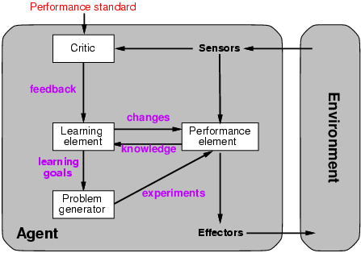
Learning Agents

Slide 5
Learning Agents
An agent is learning if it improves its performance on future tasks after making observations about the world.
Any component of an agent can be improved by learning from data.
The improvements, and the techniques used to make them, depend on four major factors:
Which component is to be improved
What prior knowledge the agent already has.
What representation is used for the data and the component.
What feedback is available to learn from.
Why would we want an agent to learn?
If the design of the agent can be improved, why wouldn’t the designers just program in that improvement to begin with?

Slide 6
There are three main reasons.
First, the designers cannot anticipate all possible situations that the agent might find itself in, for example, a robot designed to navigate mazes must learn the layout of each new maze it encounters.
Second, the designers cannot anticipate all changes over time; a program designed to predict tomorrow’s stock market prices must learn to adapt when conditions change from boom to bust.
Third, sometimes human programmers have no idea how to program a solution themselves.
For example, most people are good at recognizing the faces of family members, but even the best programmers are unable to program a computer to accomplish that task, except by using learning algorithms.

Slide 7
Learning
In general
Learning is essential for unknown environments,
i.e., when designer lacks omniscience
Learning is useful as a system construction method,
i.e., expose the agent to reality rather than trying to write it down
Learning modifies the agent's decision mechanisms to improve performance
Machine learning uses various algorithms for building mathematical models and making predictions using historical data or information.
Currently, it is being used for various tasks such as image recognition, speech recognition, email filtering, Facebook auto-tagging and recommender system.

Slide 8
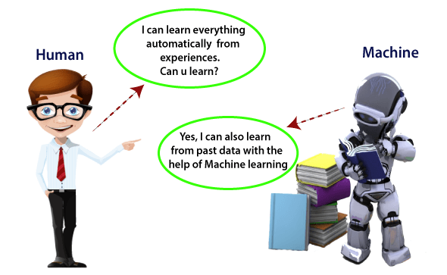

Slide 9
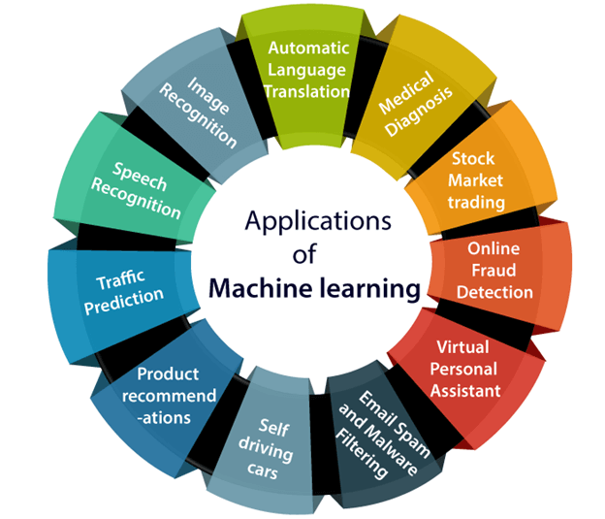
Applications of Machine learning
We are using machine learning in our daily life even without knowing it such as Google Maps, Google assistant, Alexa, etc. Below are some most trending real-world applications of Machine Learning.

Slide 10
Image Recognition
Image recognition is one of the most common applications of machine learning.
It is used to identify objects, persons, places, digital images, etc. The popular use case of image recognition and face detection is, Automatic friend tagging suggestion:
Facebook provides us a feature of auto friend tagging suggestion. Whenever we upload a photo with our Facebook friends, then we automatically get a tagging suggestion with name,& the technology behind this is machine learning's face detection and recognition algorithm.
It is based on the Facebook project named "Deep Face," which is responsible for face recognition and person identification in the picture.

Slide 11
Speech Recognition
While using Google, we get an option of "Search by voice," it comes under speech recognition, and it's a popular application of machine learning.
Speech recognition is a process of converting voice instructions into text, and it is also known as "Speech to text", or "Computer speech recognition." At present, machine learning algorithms are widely used by various applications of speech recognition.
Google assistant, Siri, Cortana, and Alexa are using speech recognition technology to follow the voice instructions.

Slide 12
Traffic prediction
If we want to visit a new place, we take help of Google Maps, which shows us the correct path with the shortest route and predicts the traffic conditions.
It predicts the traffic conditions such as whether traffic is cleared, slow-moving, or heavily congested with the help of two ways:
Real Time location of the vehicle form Google Map app and sensors
Average time has taken on past days at the same time.
Everyone who is using Google Map is helping this app to make it better.
It takes information from the user and sends back to its database to improve the performance.

Slide 13
Product Recommendations
Machine learning is widely used by various e-commerce and entertainment companies such as Amazon, Netflix, etc., for product recommendation to the user.
Whenever we search for some product on Amazon, then we started getting an advertisement for the same product while internet surfing on the same browser and this is because of machine learning.
Google understands the user interest using various machine learning algorithms and suggests the product as per customer interest.
As similar, when we use Youtube, we find some recommendations for entertainment series, movies, etc., and this is also done with the help of machine learning.

Slide 14
Self-driving cars
One of the most exciting applications of machine learning is self-driving cars.
Machine learning plays a significant role in self-driving cars. Tesla, the most popular car manufacturing company is working on self-driving car.
It is using unsupervised learning method to train the car models to detect people and objects while driving.

Slide 15
Email Spam and Malware Filtering
Whenever we receive a new email, it is filtered automatically as important, normal, and spam.
We always receive an important mail in our inbox with the important symbol and spam emails in our spam box, and the technology behind this is Machine learning.
Below are some spam filters used by Gmail:
Content Filter
General blacklists filter
Rules-based filters
Permission filters

Slide 16
Online Fraud Detection
Machine learning is making our online transaction safe and secure by detecting fraud transaction.
Whenever we perform some online transaction, there may be various ways that a fraudulent transaction can take place such as fake accounts, fake ids, and steal money in the middle of a transaction.
So to detect this, Feed Forward Neural network helps us by checking whether it is a genuine transaction or a fraud transaction.

Slide 17
Automatic Language Translation
Nowadays, if we visit a new place and we are not aware of the language then it is not a problem at all, as for this also machine learning helps us by converting the text into our known languages.
Google's GNMT (Google Neural Machine Translation) provide this feature, which is a Neural Machine Learning that translates the text into our familiar language, and it called as automatic translation.
The technology behind the automatic translation is a sequence to sequence learning algorithm, which is used with image recognition and translates the text from one language to another language.

Slide 18
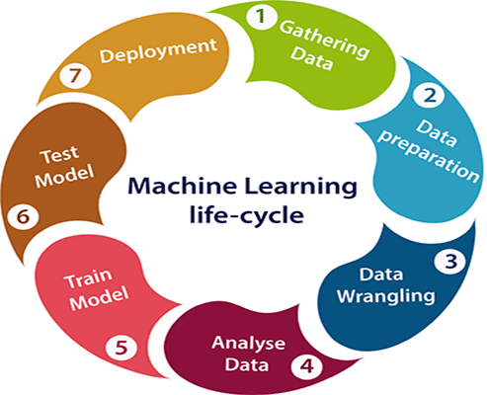
Machine learning Life cycle
Machine learning has given the computer systems the abilities to automatically learn without being explicitly programmed.
But how does a machine learning system work? So, it can be described using the life cycle of machine learning.
Machine learning life cycle is a cyclic process to build an efficient machine learning project.
Machine learning life cycle involves seven major steps, which are given below:
Gathering Data
Data preparation
Data Wrangling
Analyse Data
Train the model
Test the model
Deployment

Slide 19
Gathering Data
Data Gathering is the first step of the machine learning life cycle.
The goal of this step is to identify and obtain all data-related problems.
Identify the different data sources, as data can be collected from various sources such as files, database, internet, or mobile devices.
Identify various data sources
Collect data
Integrate the data obtained from different sources
By performing the above task, we get a coherent set of data, also called as a dataset.

Slide 20
Data preparation
After collecting the data, we need to prepare it for further steps.
Data preparation is a step where we put our data into a suitable place and prepare it to use in our machine learning training.
Data exploration: It is used to understand the nature of data that we have to work with. We need to understand the characteristics, format, and quality of data.
A better understanding of data leads to an effective outcome.

Slide 21
Data Wrangling
Data wrangling is the process of cleaning and converting raw data into a useable format.
It is the process of cleaning the data, selecting the variable to use, and transforming the data in a proper format to make it more suitable for analysis in the next step.
Collected data may have various issues, including:
Missing Values
Duplicate data
Invalid data
Noise
So, we use various filtering techniques to clean the data.

Slide 22
Data Analysis
Now the cleaned and prepared data is passed on to the analysis step.
This step involves:
Selection of analytical techniques
Building models
Review the result
Train Model
The next step is to train the model, in this step we train our model to improve its performance for better outcome of the problem.
We use datasets to train the model using various machine learning algorithms. Training a model is required so that it can understand the various patterns, rules, and, features.

Slide 23
Test Model
Once our machine learning model has been trained on a given dataset, then we test the model.
we check for the accuracy of our model by providing a test dataset to it.
Testing the model determines the percentage accuracy of the model as per the requirement of project or problem.
Deployment
The last step of machine learning life cycle is deployment, where we deploy the model in the real-world system.
Key points
Difference between Artificial intelligence and Machine (Reading assignment )

Slide 24
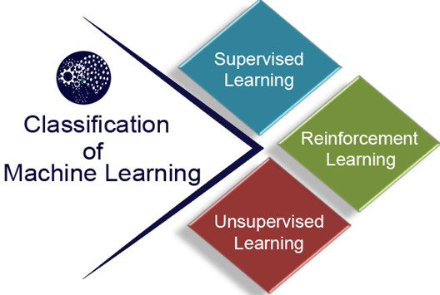
Classification of Machine Learning
Machine learning can be classified into three types:
Supervised learning
Unsupervised learning
Reinforcement learning

Slide 25
1. Supervised Learning
Supervised learning is a type of machine learning method in which we provide sample labelled data to the machine learning system in order to train it, and on that basis, it predicts the output.
The system creates a model using labelled data to understand the datasets and learn about each data.
Once the training and processing are done then we test the model by providing a sample data to check whether it is predicting the exact output or not.
The goal of supervised learning is to map input data with the output data.
The supervised learning is based on supervision, and it is the same as when a student learns things in the supervision of the teacher.
The example of supervised learning is spam filtering.

Slide 26
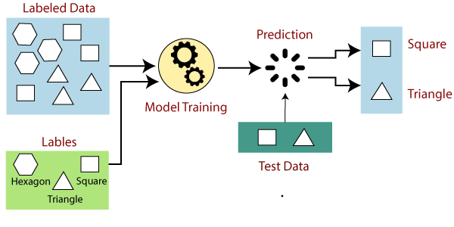
Supervised Learning
Supervised learning can be grouped further in two categories of algorithms:
Classification
Regression

Slide 27
Example 1: We may use supervised learning to predict house prices. Data having details about the size of the house, price, the number of rooms in the house, garden and other features are needed. We need data about various parameters of the house for thousands of houses and it is then used to train the data. This trained supervised machine learning model can now be used to predict the price of a house.
Example 2: Spam detection is another area where most organizations’ use supervised machine learning algorithms. Data scientists classify different parameters to differentiate between official mail or spam mail. They use these algorithms to train the database such that the trained database recognize patterns in new data and classify them into spam and non-spam communication efficiently.

Slide 28
2. Unsupervised Learning
Unsupervised learning is a learning method in which a machine learns without any supervision.
The training is provided to the machine with the set of data that has not been labelled, classified, or categorized, and the algorithm needs to act on that data without any supervision.
The goal of unsupervised learning is to restructure the input data into new features or a group of objects with similar patterns.
In unsupervised learning, we don't have a predetermined result.
The machine tries to find useful insights from the huge amount of data.

Slide 29
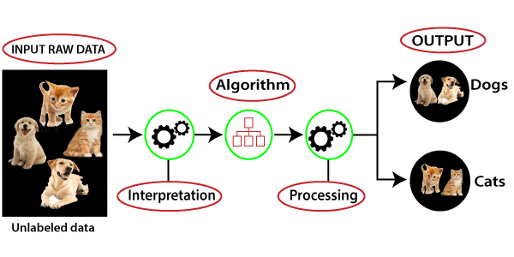
Unsupervised Learning
It can be further classifieds into two categories of algorithms:
Clustering
Association

Slide 30
3. Reinforcement Learning
Reinforcement learning is a feedback-based learning method, in which a learning agent gets a reward for each right action and gets a penalty for each wrong action.
The agent learns automatically with these feedbacks and improves its performance.
In reinforcement learning, the agent interacts with the environment and explores it.
The goal of an agent is to get the most reward points, and hence, it improves its performance.
The robotic dog, which automatically learns the movement of his arms, is an example of Reinforcement learning.

Slide 31
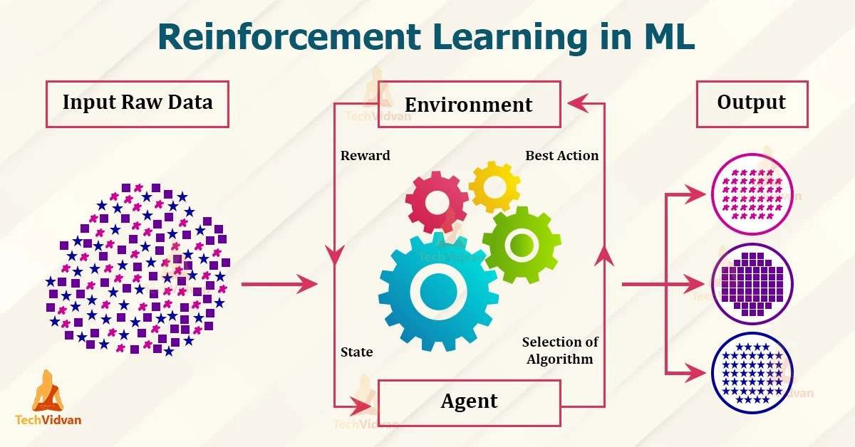
Reinforcement Learning

Slide 32
Thanks

